Slide 1
4CCS1ISE – Introduction to Software Engineering
6.1 Sequence diagrams basics
Dr Leonardo Magela Cunha, Dr Steffen Zschaler
February, 2021

Slide 2
Interaction Diagrams
Used to specify interactions
Modeling concrete scenarios
Describing communication sequences at different levels of detail
Interaction Diagrams show the following:
Interaction of a system with its environment
Interaction between system parts in order to show how a specific use case can be implemented
Interprocess communication in which the partners involved must observe certain protocols
Communication at class level (operation calls, inter-object behavior)

Slide 3
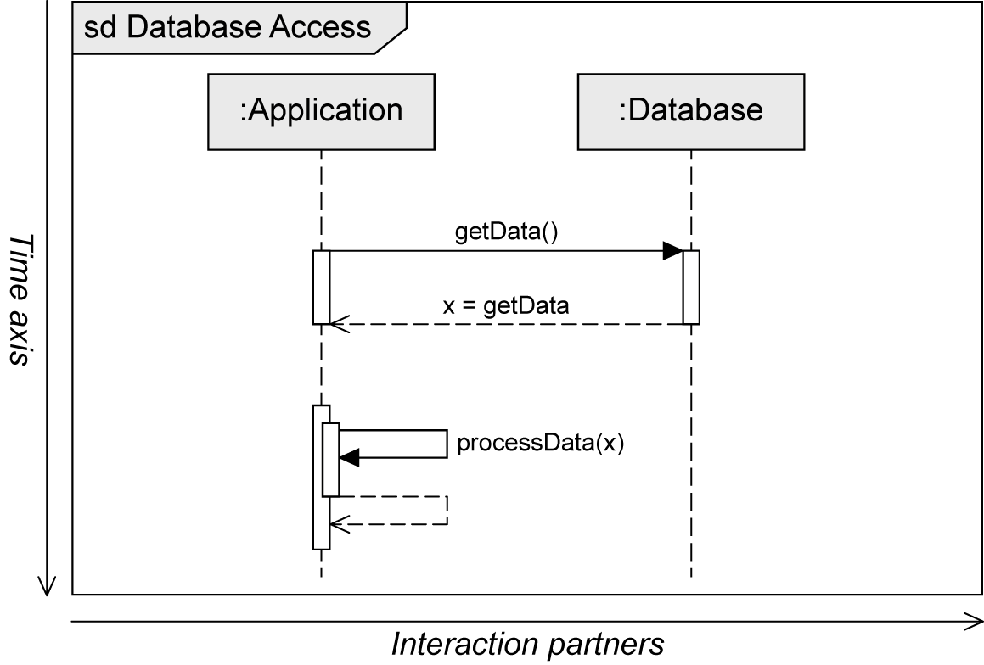
Sequence Diagram
Two-dimensional diagram
Horizontal axis: involved interaction partners
Vertical axis: chronological order of the interaction
Interaction = sequence of event specifications

Slide 4
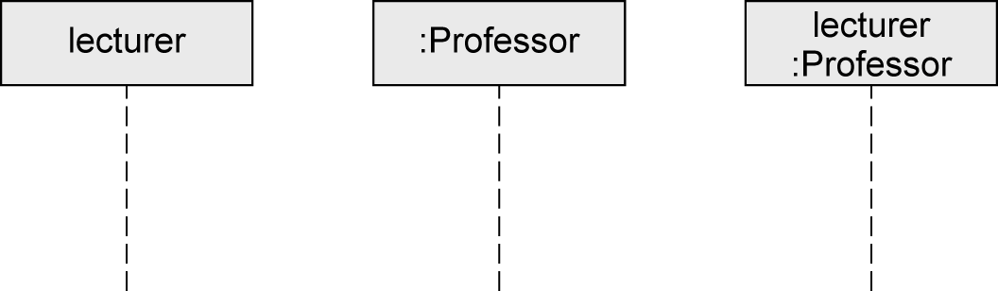
Interaction Partners
Interaction partners are depicted as lifelines
Head of the lifeline
Rectangle that contains the expression roleName:Class
Roles are a more general concept than objects
Object can take on different roles over its lifetime
Body of the lifeline
Vertical, usually dashed line
Represents the lifetime of the object associated with it
Head of the lifeline
Body of the Lifeline

Slide 5
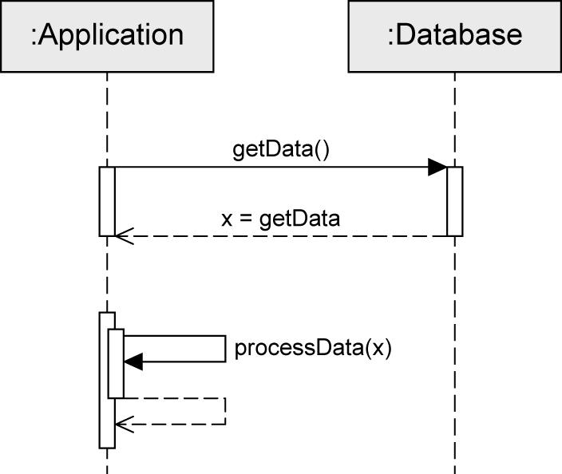
Exchanging Messages
Interaction: sequence of events
Message is defined via send event and receive event
Execution specification
Continuous bar
Used to visualize when an interaction partner executes some behavior
Send event
Receive event
Execution specification

Slide 6
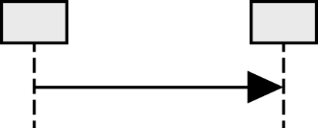
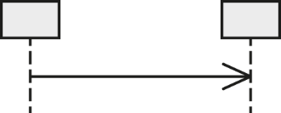

Messages (1/3)
Synchronous message
Sender waits until it has received a response message before continuing
Syntax of message name: msg(par1,par2)
msg: the name of the message
par: parameters separated by commas
Asynchronous message
Sender continues without waiting for a response message
Syntax of message name: msg(par1,par2)
Response message
May be omitted if content and location are obvious
Syntax: att=msg(par1,par2):val
att: the return value can optionally be assigned to a variable
msg: the name of the message
par: parameters separated by commas
val: return value

Slide 7
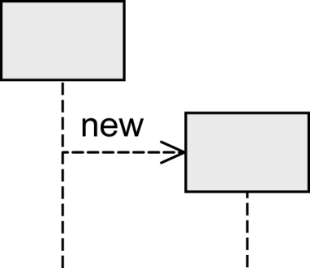
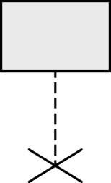
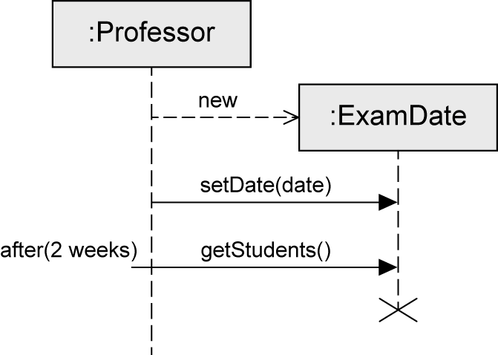
Messages (2/3)
Object creation
Dashed arrow
Arrowhead points to the head of the lifeline of the object to be created
Keyword new
Object destruction
Object is deleted
Large cross (×) at the end of the lifeline

Slide 8
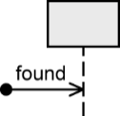
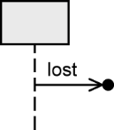
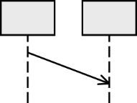
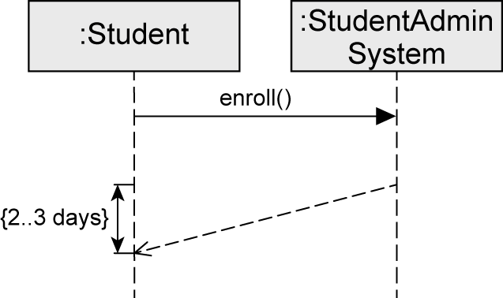
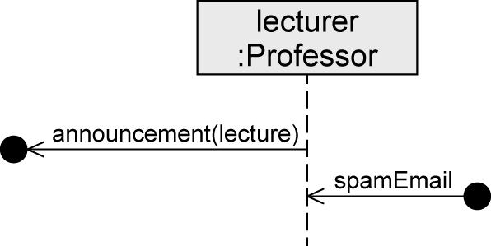
Messages (3/3)
Found message
Sender of a message is unknown or not relevant
Lost message
Receiver of a message is unknown or not relevant
Time-consuming message
"Message with duration"
Usually messages are assumed to be transmitted without any loss of time
Express that time elapses between the sending and the receipt of a message

Slide 9
Conclusions
Learning objectives
After this session
You understand the basic elements of a sequence diagram.
Create UML sequence diagrams;
What Next?
Sequence diagram fragments

Slide 10
Contact details/for more information Leonardo Magela Cunha
leonardo.magela@kcl.ac.uk
© 2021 King’s College London. All rights reserved

Slide 11
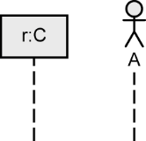
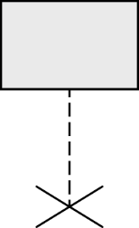
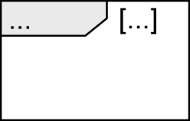
Notation Elements (1/2)
Name | Notation | Description
Lifeline |  | Interaction partners involved in the communication
Destruction event |  | Time at which an interaction partner ceases to exist
Combined fragment |  | Control constructs

Slide 12
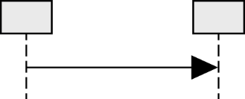
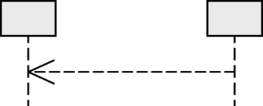

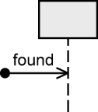
Notation Elements (2/2)
Name | Notation | Description
Synchronous message |  | Sender waits for a response message
Response message |  | Response to a synchronous message
Asynchronous communication |  | Sender continues its own work after sending the asynchronous message
Lost message |  | Message to an unknown receiver
Found message |  | Message from an unknown sender

Slide 13
References
Http://uml.org
UML @ Classroom: An Introduction to Object-Oriented Modeling
Martina Seidl, Marion Scholz, Christian Huemer and Gerti Kappel, Springer Publishing, 2015, ISBN 3319127411
UML@Classroom powerpoint slides by Martina Seidl, Marion Scholz, Christian Huemer and Gerti Kappel are published under the Creative Commons Attribution-NonCommercial 4.0 International license.
UML Distilled: A Brief Guide to the Standard Object Modeling Language
Martin Fowler, Addison-Wesley Professional, 2003, ISBN: 0321193687
UML in a Nutshell
Sinan Alhir, O'Reilly Media,1998, ISBN: 1-56592-448-7
Software Engineering, Global Edition
Ian Sommerville, Pearson, 10th edition (20 Aug. 2015), ISBN-10: 9781292096131
Slides adapted from https://www.slideshare.net/software-engineering-book/ch5-system-modeling

